Slide 1
EcoPots
Eco-friendly vases and planters made from recycled plastic and wood

Slide 2


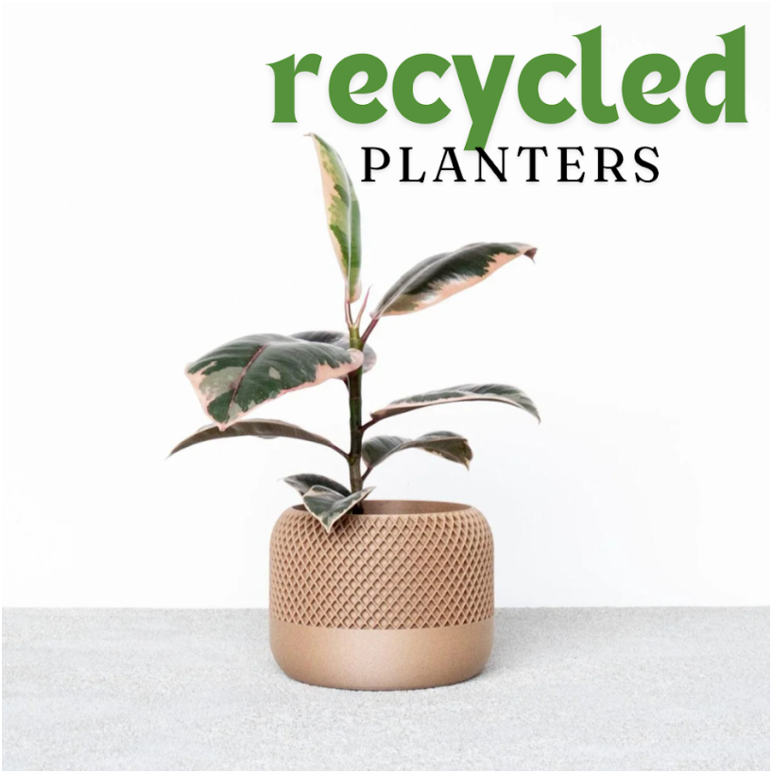
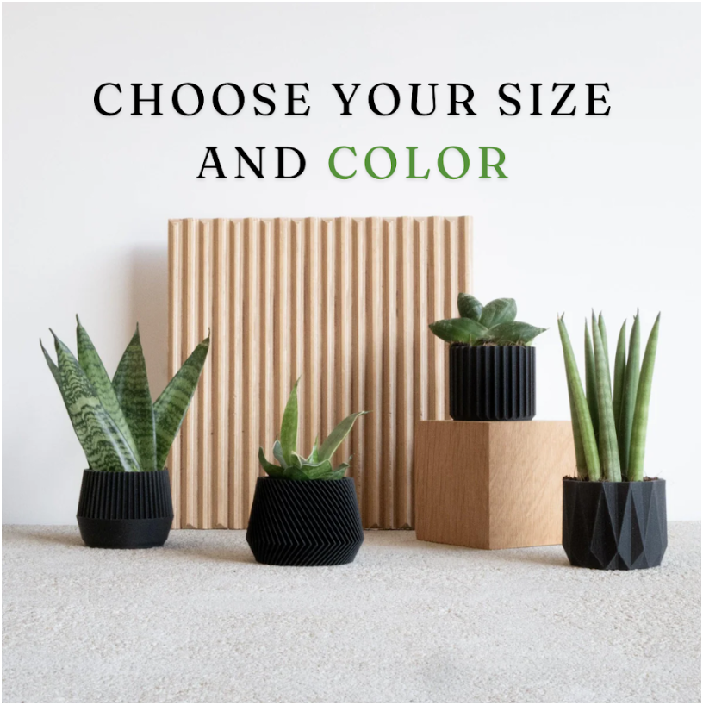

Slide 3
Business, Marketing, Campaign Goals
Business Objectives:
Achieve 2000 sales within the first year.
Stable paid and organic traffic from various sources (Google Search, Soc media - Pinterest mostly, etc.)
Establish brand presence and awareness within the first year.
Marketing Objectives:
Achieve 1000 sales through Google Ads within the first 6 months.
Drive 10000 visitors to the website per month via Google Ads within the first 6 months.
Achieve a CTR of >5% on Google Ads within the first 6 months.
Campaign Goal:
Achieve 150 sales from the search campaign within the first month.
Drive 6000 new visitors per month through the search campaign.
Achieve a conversion rate of 2,5% on search ads within the first month.
Main KPI’s to track: CTR, CPA, CPC, ROAS, Sales, AOV, Revenue, Website visitors.
Also important: Bounce rate, what products sell the most (we might launch separate ads for them), highest ranking keywords, organic traffic.

Slide 4
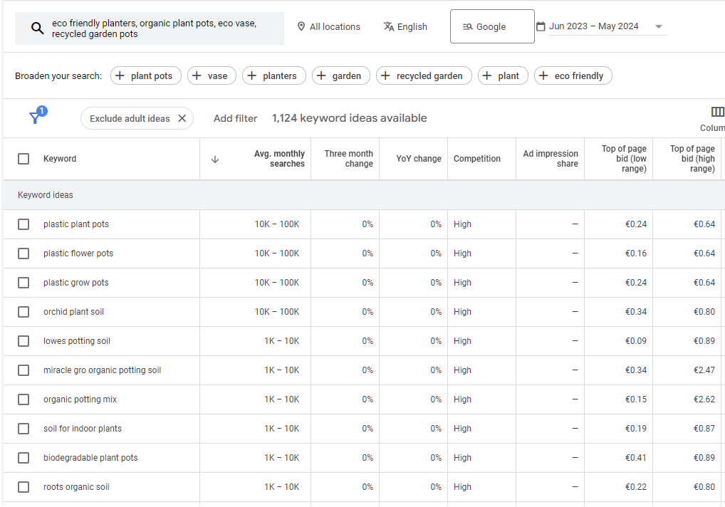
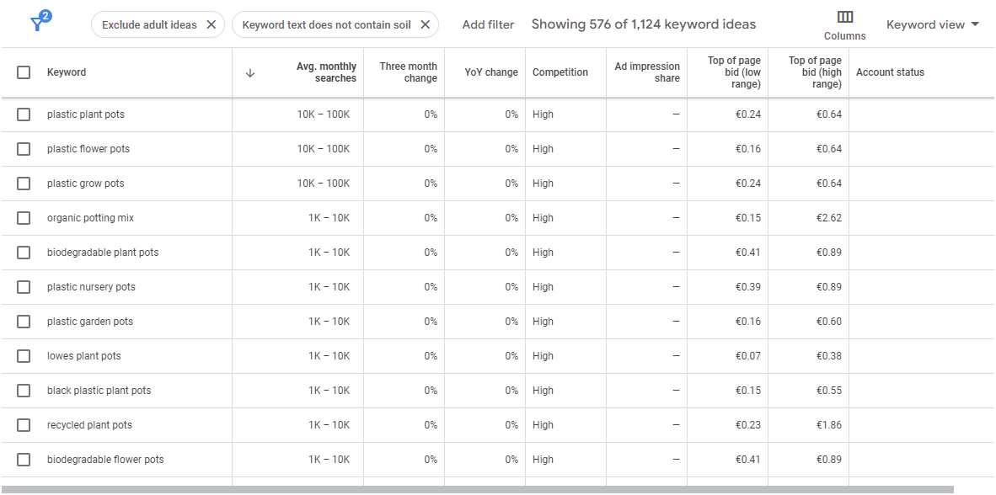
Checking keywords like "eco-friendly planters," "recycled plastic vases," "sustainable garden pots," "eco vases," and "recycled wood planters" I’ve got some results that include “SOIL” as a keyword, so I decided to add that as a negative keyword to get more relevant results.
1st search:
Search with negative keywords:

Slide 5
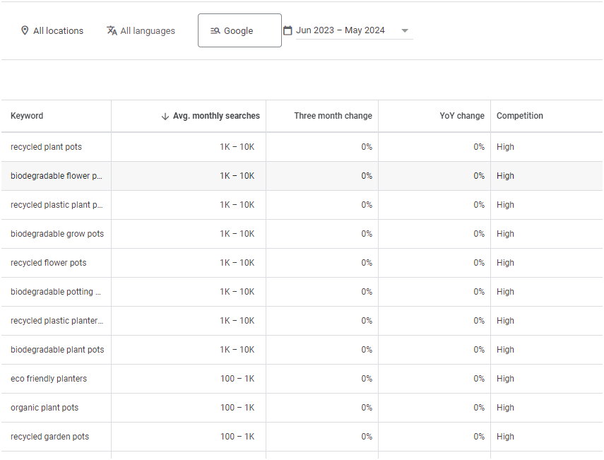
After selecting the specific keywords I can see there’s not enough monthly searches, so in this case we will use more generic keywords and keep the “Eco-Friendly” part as our USP.

Slide 6
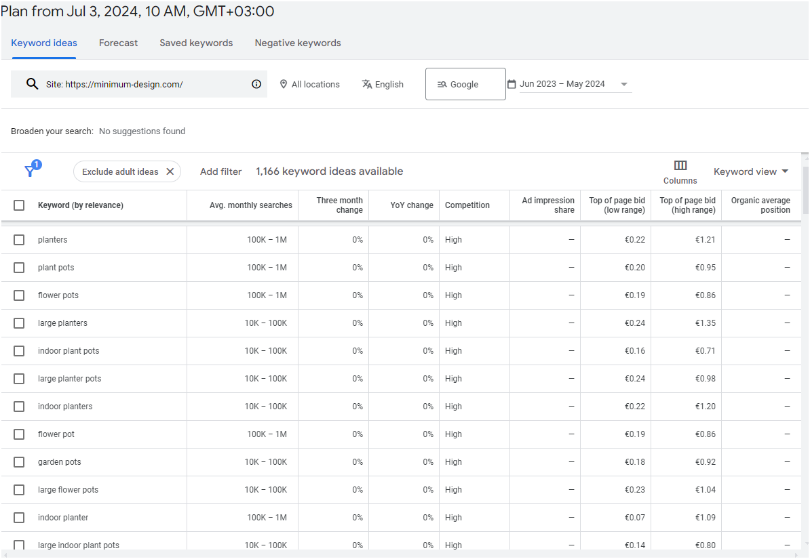
After doing some research, I found a well established competitor that sells exact same products, so we will mostly copy the keywords, unless it doesn’t fit our business (for example color or size in the keyword that we don’t sell)
https://minimum-design.com/

Slide 7
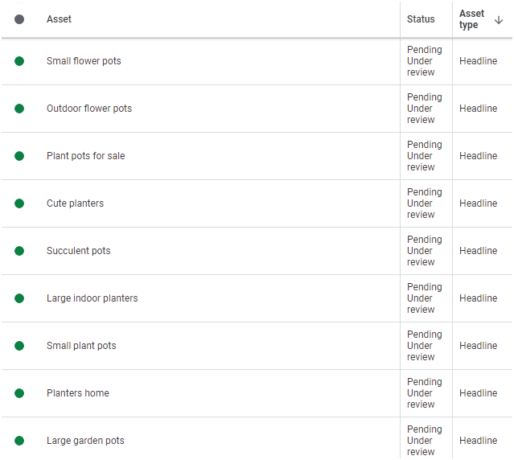
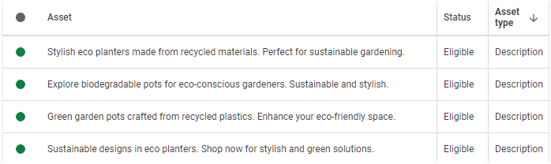
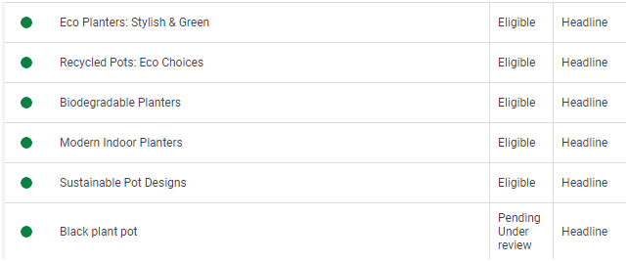
15 Headlines that include main keywords
and 4 Unique descriptions

Slide 8
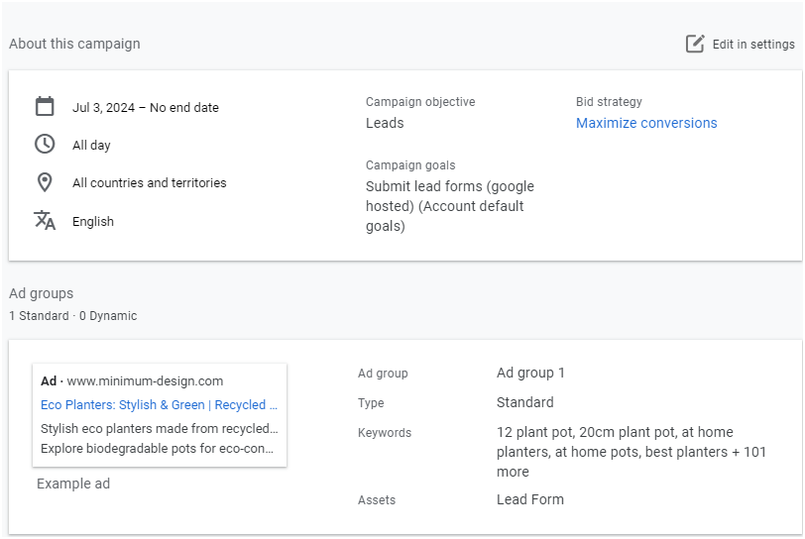
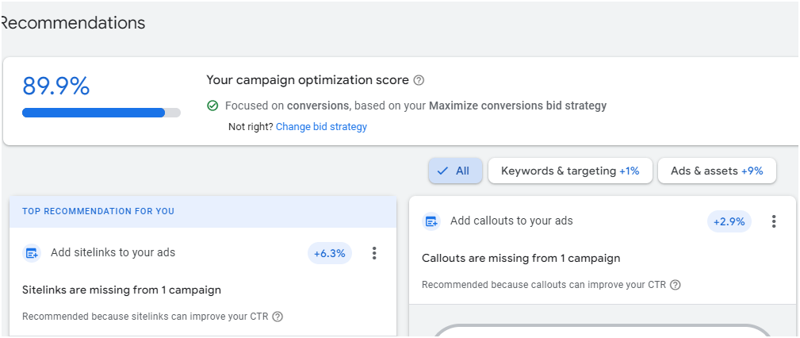
Launched a Search campaign with objective - Leads.
With a set of 30 EUR daily budget estimated weekly conversions were ~ 44 with an estimated CPA of ~ 5,5 EUR
Creating 15 Headlines that include main keywords and 4 unique descriptions helped me reach 89,9% optimization score.
Adding sitelinks and callouts would increase the score to 99,1%

Slide 9
Looking back at our campaign goals:
150 sales, 6000 new visitors, conversion rate of 2,5% within the first month.
We can see that we’ve set a realistic goal with only 30 EUR daily spending on ads. Since estimated conversions are 44 weekly (~180 monthly) we should reach our monthly goal with the 6000 visitors and conversion rate of 2,5%.
Though we have to consider if visitors are going to convert, we might encounter other problems not related to Google Ads, etc.
We can also see that our campaign goals align with marketing goals and business as well, if we take sales as an example:
150 monthly, 1000 in 6 months (167 monthly), 2000 in a year (167 monthly)

